Slide 1
Anime Predictions
Heather Garcia and Tyler Reed

Slide 2

Challenge
Find a real-world problem that impacts you and use data driven methodologies to find a solution to the problem.
Tyler and I have kids that both like Anime.
Can we figure out how Otaku rate Anime?
What factors are most common to a high rating (8-10)?
Fairy Tail
Anime

Slide 3
Challenge Accepted
Our Data
Contains informations about Anime and Otaku who watch it
Anime is a style of hand-drawn and computer animation originating in, and commonly associated with, Japan
Otaku is a Japanese term for people with obsessive interests, commonly towards the anime and manga fandom
Manga are comics created in Japan or by creators in the Japanese language, conforming to a style developed in Japan in the late 19th century.
Our Challenge
How accurately can we predict a user rating an anime high?

Slide 4
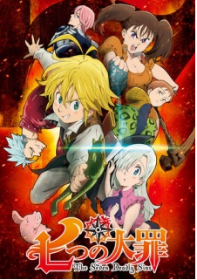
Finding Data
Seven Deadly Sins
Three Datasets
My Anime List
Anime Recommendations Database
Anime Data (Score, Staff, Synopsis, and Genre)
Same Source
Myanimelist.net
Narrow the List
Dataset: My Anime List
Anime

Slide 5
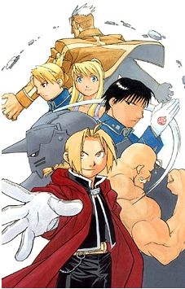
Initial Challenges
Fullmetal Alchemist
Dataset Versions
Original
Cleaned
Filtered
Large Volumes
One file contained over 64M records
Our poor machines couldn’t keep up!
Fix: read file 2000 rows at a time, randomly pick 20
Manga

Slide 6

Search for Predictors
One Piece
Initial Scrub: Process of Elimination
Columns that are a repeat of each other
Title, Japanese Title
ID Columns
Text Mining
No Documentation
Near Zero Variance
Manga

Slide 7
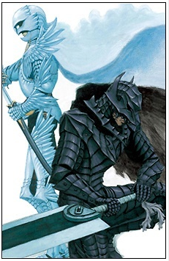
Data Exploration and Preprocessing
Berserk
Skewness?
Near Zero Variance?
Continuous vs. Categorical Predictors?
Categorical - How Many Levels?
Categorical | Continuous
13 | 13
Manga

Slide 8
Data Cleaning

Slide 9
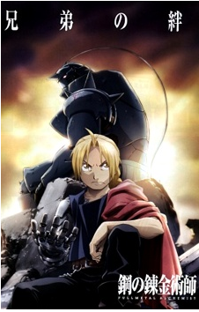
Feature Selection
Fullmetal Alchemist: Brotherhood
Stepwise AIC
Direction = Both
Logistic Regression
Final Features
Source of the anime | rank | Rating | gender
Length of show | popularity | User on hold fromwatch | favorites
User stopped watching | Day of the week show is on | User planned to watch
Score of anime | User Watching | Last year user online
Number of member scored the anime | User completed watching | Year User joined site
Anime

Slide 10
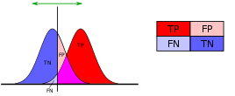
Model Accuracy
Our Choice: Sensitivity

Slide 11
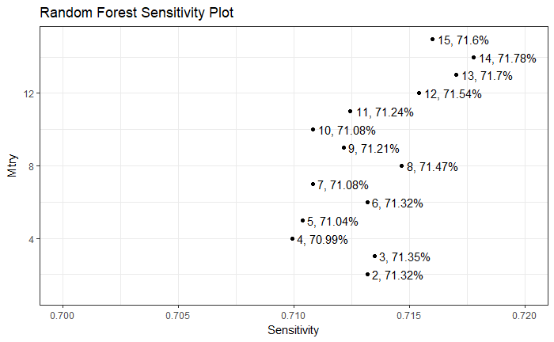
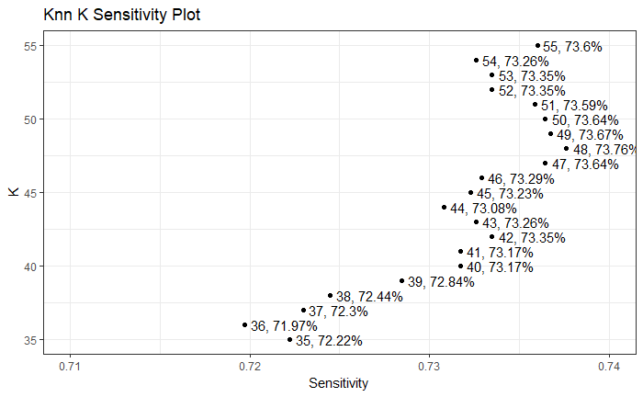
Model Tuning, Training Results
Random Forest
Mtry = 14
Sensitivity = 71.78%
Also to note: 6, 71.32%
K-Nearest Neighbor
K = 48
Sensitivity = 73.76%

Slide 12
Model Tuning, Training Results
Logistic Regression
Sensitivity = 71%
Support Vector Machine

Slide 13
Accuracy forecasting
Random Forest best model accuracy:
Perdiction | High | Low
High | 1558 | 747
Low | 691 | 1337
69.28%
K-Nearest Neighbor best model accuracy:
Perdiction | High | Low
High | 1626 | 941
Low | 623 | 1143
72.3%

